Slide 1
Digital Signature

Slide 2
Introduction
A digital signature is a cryptographic method used to verify that a digital document, message, or file is authentic, has not been altered, and was signed by the claimed sender.
Example: Signing a document or a cheque.
Benefits of digital signature:
Authenticity: Confirms the identity of the sender.
Integrity: Ensures the document has not been modified after signing.
Non-repudiation: Prevents the sender from denying that he signed the document.

Slide 3
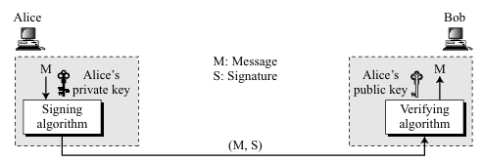
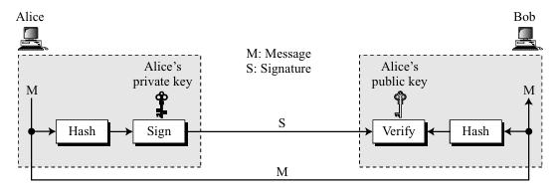
Digital Signature Process
A digital signature needs a public-key system. The signer signs with its private key, the verifier verifies with the signer’s public key.
A cryptosystem uses the private and public keys of the receiver. Whereas a digital signature uses the private and public keys of the sender.

Slide 4
Difference between Conventional Signature & Digital Signature
Basis | Conventional Signature | Digital Signature
1. Inclusion | The signature is included in the document. It is physically part of the document. For example, a handwritten signature on a cheque. | The signature is separate from the message/document. The sender sends the message and the digital signature as separate components.
2. Verification Method | The recipient verifies the signature by visually comparing it with a known/authenticated copy of the sender's signature. | The recipient verifies the signature using a cryptographic verification technique, typically using the sender's public key and the received message.
3. Relationship | There is normally a one-to-many relationship between a signature and documents. The same handwritten signature can be used to sign many different documents. | There is a one-to-one relationship between a digital signature and a message. A signature generated for one message cannot normally be reused to authenticate another message.
4. Duplicity | A copy of the signed document can be distinguished from the original document on file. Thus, the original and a photocopy are distinguishable. | There is generally no inherent distinction between an original and a copy of a digitally signed document. A digital copy can be identical to the original. Therefore, additional mechanisms such as a timestamp, transaction number, or unique identifier may be required to prevent replay/duplication.
Example | Alice signs a paper cheque with a pen. The signature is physically present on the cheque. | Alice signs an electronic payment message using her private key. Bob receives the message along with its digital signature and verifies it using Alice's public key.

Slide 5
Security Services & Digital Signature
Message Authentication:
A digital signature provides message authentication, also called data-origin authentication.
It allows the receiver to verify that the message was actually sent by the claimed sender.
A signature created using Eve's private key cannot normally be verified using Alice's public key.
Message Integrity:
A digital signature provides message integrity.
It ensures that the message has not been modified after it was signed.
The hash value changes if even a small part of the message is modified.
Therefore, a modified message will fail signature verification.

Slide 6
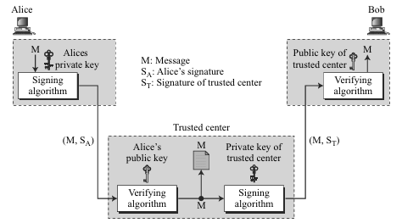
Security Services & Digital Signature
Nonrepudiation:
A digital signature can provide nonrepudiation, meaning that a sender cannot easily deny having signed a message.
However, a basic digital signature scheme alone may not be sufficient for strong nonrepudiation. (If sender changes keys later)
Trusted-center:
Alice signs the message using her private key.
Alice sends the message, her signature, and her identity to the trusted center.
The trusted center verifies Alice's signature using Alice's public key.
The trusted center stores the message, sender identity, recipient identity, and timestamp.
The trusted center creates its own signature over the message.
The trusted center sends the message and its signature to Bob.
Bob verifies the trusted center's signature using the trusted center's public key.
If Alice later denies sending the message, the trusted center can provide the stored record and evidence of the transaction.

Slide 7
Security Services & Digital Signature
Confidentiality:
A digital signature protects authentication and integrity, but it does not hide the contents of the message.
If confidentiality is required, encryption must additionally be applied.
A digital signature does not provide confidentiality.
A digital signature provides message authentication, message integrity, and can support nonrepudiation, but it does not provide confidentiality; encryption must be added when privacy is required.

Slide 8
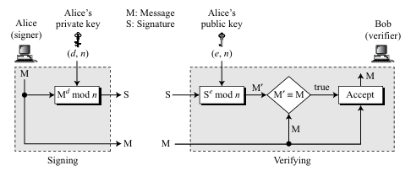
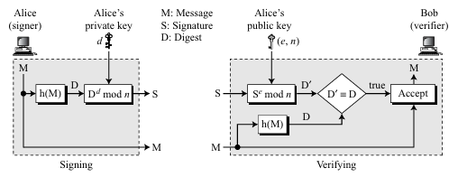
RSA Digital Signature Scheme

Slide 9
RSA Digital Signature Scheme Comparison
Feature | RSA Signature on Entire Message | RSA Signature on Message Digest
Input to RSA | Entire message | Hash/message digest
Message size | Limited by RSA block/modulus constraints | Can handle very large messages
Efficiency | Poor for large messages | Very efficient
RSA computation | Potentially repeated/awkward for large data | RSA operates on a small fixed-size encoded digest
Hash function required | Not necessarily | Yes
Integrity protection | Directly represents the message | Hash detects changes to the message
Signature size | Determined by RSA modulus | Determined by RSA modulus
Processing large files | Impractical | Practical
Modern use | Generally not recommended as raw RSA | Standard approach

